Slide 1
SAP EWM EXTENDED WAREHOUSE MANAGEMENT TRAINING
AnubhavTrainings.com
www.anubhavtrainings.com

Slide 2

SAP EWM TRAINING
BY:-
Mr. Bijoy
www.anubhavtrainings.com
Notes:
https://unsplash.com/photos/uXB-7la5vqA

Slide 3
SAP EWM TRAINING (Day 05)
AnubhavTrainings.com

Slide 4
Inbound Process / Putaway Process
Delivery document types for Inbound, Item types for Inbound,
Putaway strategies, Storage type Search, Stroage section search, Storage bin determination
End to End Inbound process – testing execution

Slide 5
EWM PACKAGING SPECIFICATION
Contents
A packaging specification is master data. The packaging specification defines all the necessary packing levels for a product for example to put away or transport the product. For a product, a packaging specification mainly describes in which quantities you can pack the product into which packaging materials.
Use
For automatic HU creation
In printed form, a packaging specification is a set of instructions for the employee in the warehouse. More specifically, the work steps that you enter in a packaging specification are intended as information for the employee. For example, give the employee exact instructions as to where to place the label on a box, or how a product should be stacked onto a pallet. The system can determine packaging specifications during various processes. Processes that determine packaging specifications use only specific attributes from the packaging specification.
Maintain structure of packaging specifications starts with header, contents, Level type, element type, level set, define work step, and define packing material type. In order to understand structure of pack spec see below figure.

Slide 6
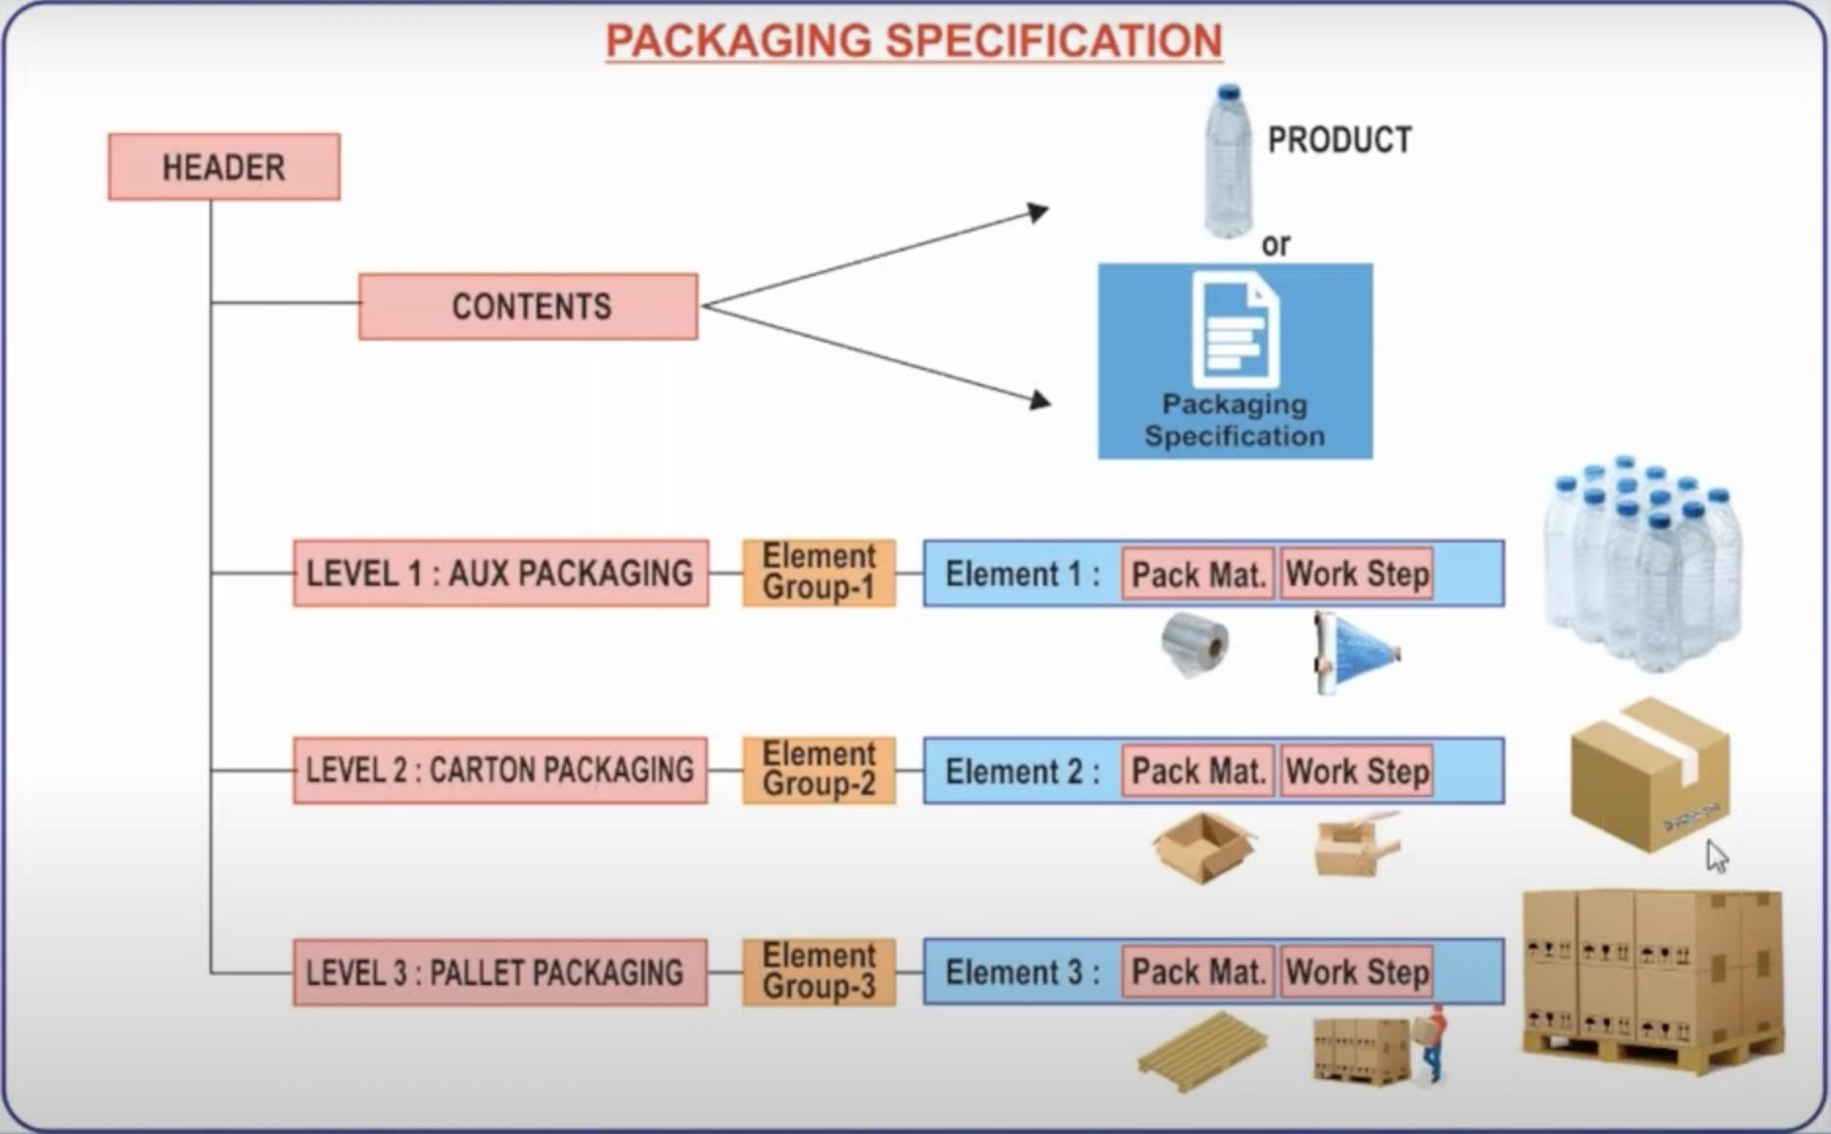
Maintain structure of packaging specifications starts with header, contents, Level type, element type, level set, define work step, and define packing material type. In order to understand structure of pack spec see below figure.

Slide 7
Example for a packaging specification and its structure
Header: Name: Pack Spec X
Contents: product X, 1 each
Level 1: Target quantity one, element group EG1
Element group EG1:
Element E1: packaging material ‘Carton box’, work step ‘Place 1 Each upright in each box’
Level 2: Target quantity 100, element group EG2
Element group EG2:
Element E2: packaging material ‘Pallet’, work step ‘Place boxes layer by layer onto pallet’
Packaging specifications can be created, copied, activated and determined using condition technique

Slide 8
Contents
Define Level Type
Define Element Type
Define Level Set
Define Packaging Material Type
Assign Packaging Material Type To Element Type
Define Packaging Specification Group
Maintain The Master Data By /Scwm/Packspec

Slide 9
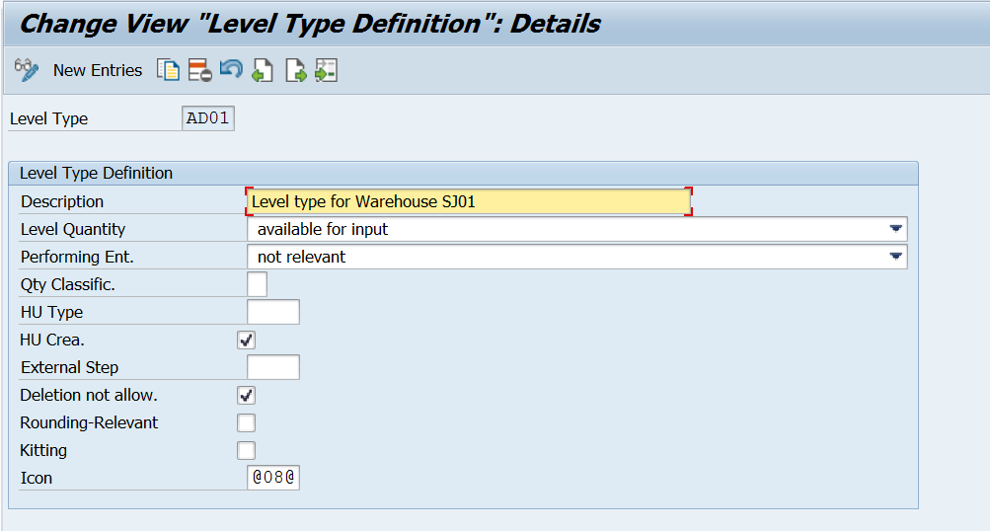
Define Level Type
A packaging specification contains one or more levels. Each level contains a target quantity, which defines how many times you can pack the previous level into this level.
EWM > Master data > Packaging Specification > Maintain structure of Packaging specification

Slide 10
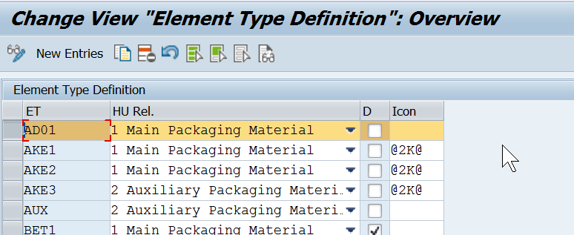
DEFINE ELEMENT TYPE
For each level there is exactly one element group. However, you can reuse element groups in several packaging specifications

Slide 11
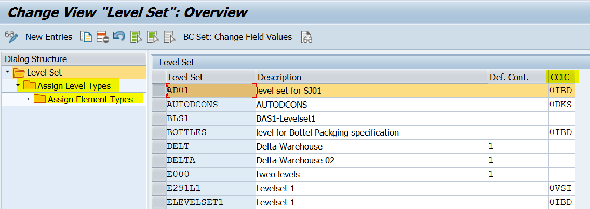
DEFINE LEVEL SET
You can map various packing levels in a packaging specification. Each level contains a target quantity, which defines how many times you can pack the previous level into this level.

Slide 12
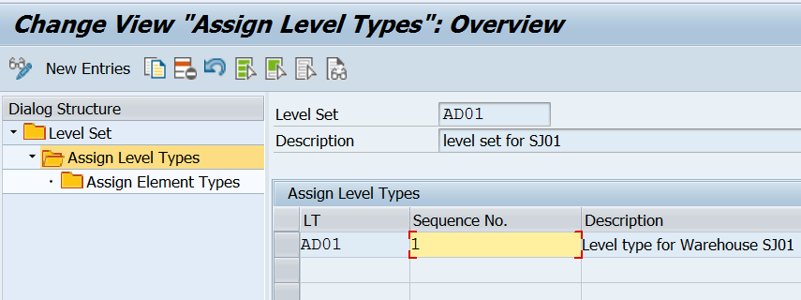
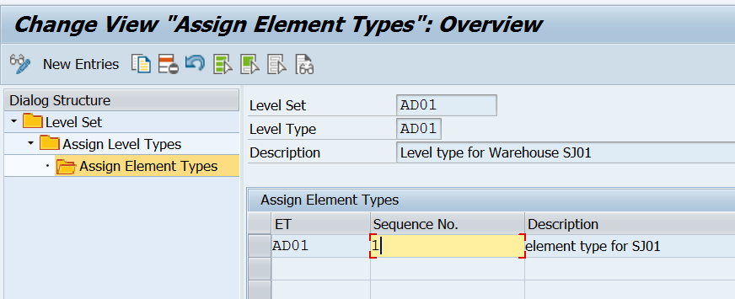
www.anubhavtrainings.com

Slide 13
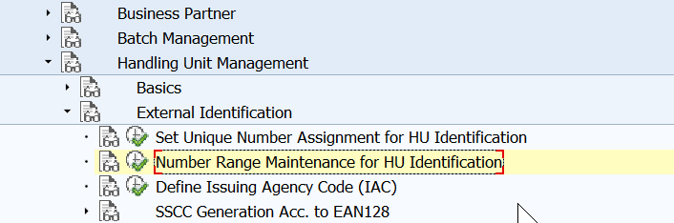
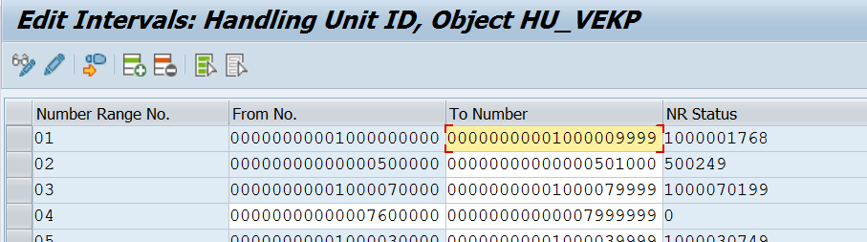
Define number range interval
www.anubhavtrainings.com

Slide 14
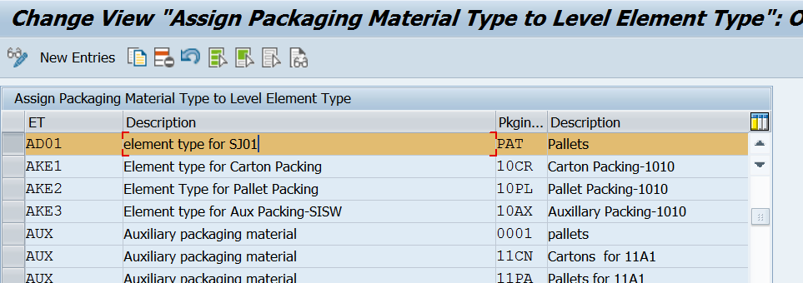
ASSIGN PACKAGING MATERIAL TYPE TO ELEMENT TYPE
www.anubhavtrainings.com

Slide 15
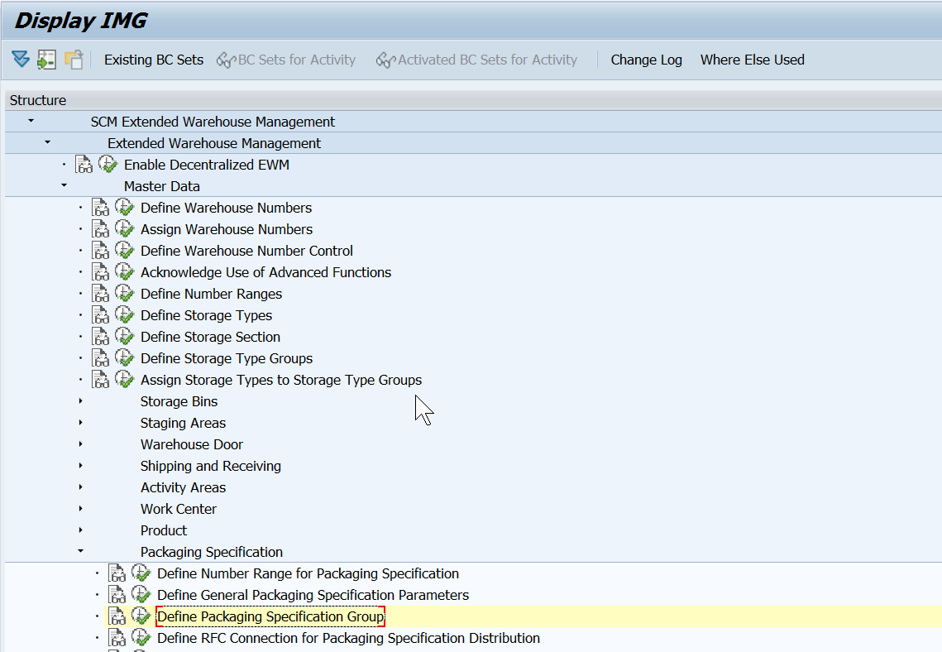
Define Packaging Specification Group
www.anubhavtrainings.com

Slide 16
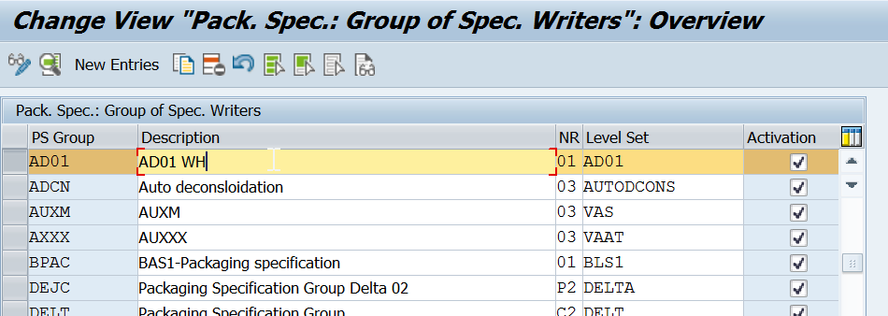
www.anubhavtrainings.com

Slide 17
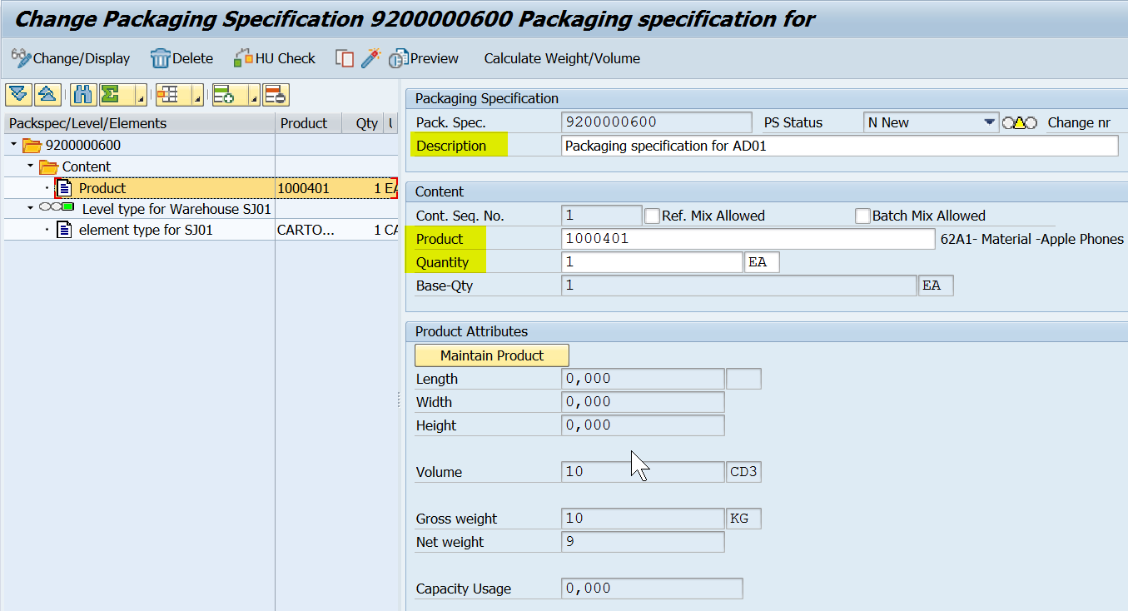
www.anubhavtrainings.com

Slide 18
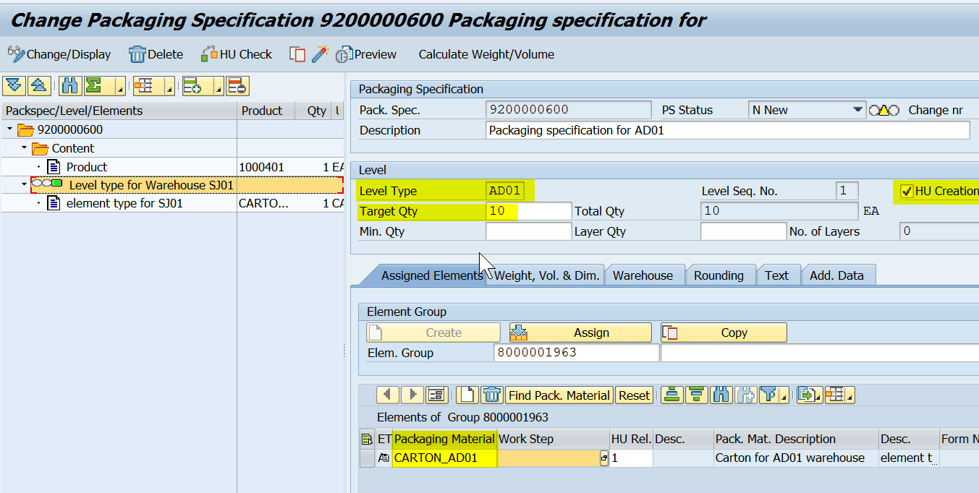
www.anubhavtrainings.com

Slide 19
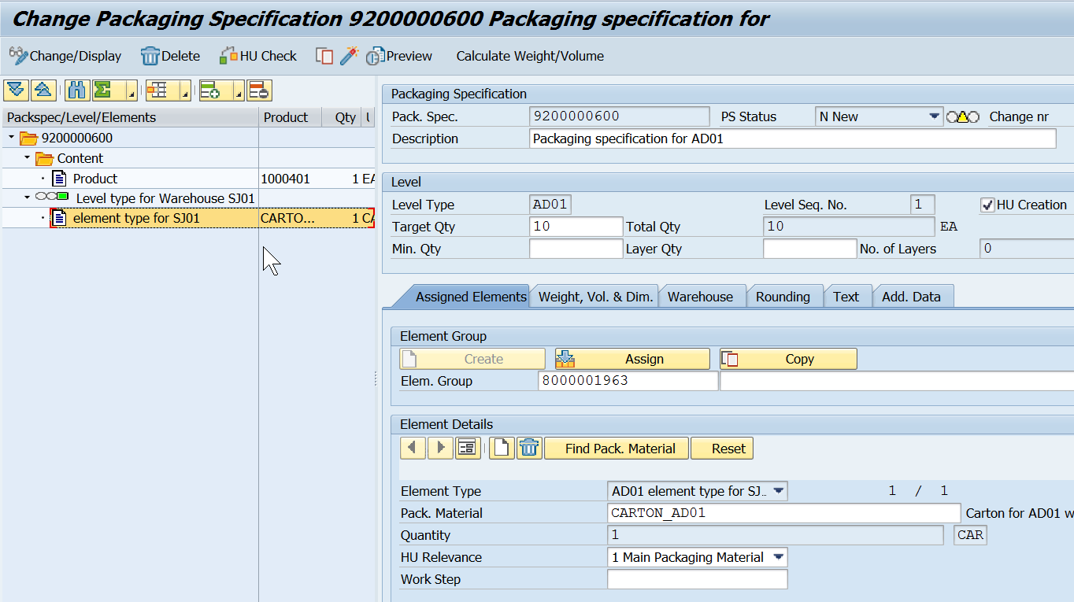
Enter the details and activate the Object.
Mass upload of Packaging specifications - /scwm/ipu
www.anubhavtrainings.com

Slide 20
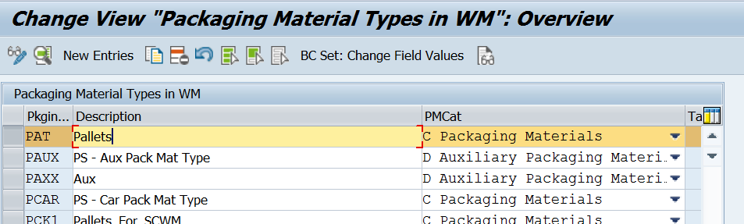
www.anubhavtrainings.com

Slide 21
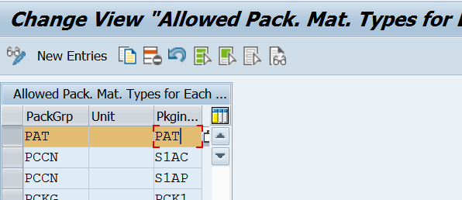
Maintain allowed packaging material type for packing group
Concept of this step is same as ERP side
www.anubhavtrainings.com

Slide 22
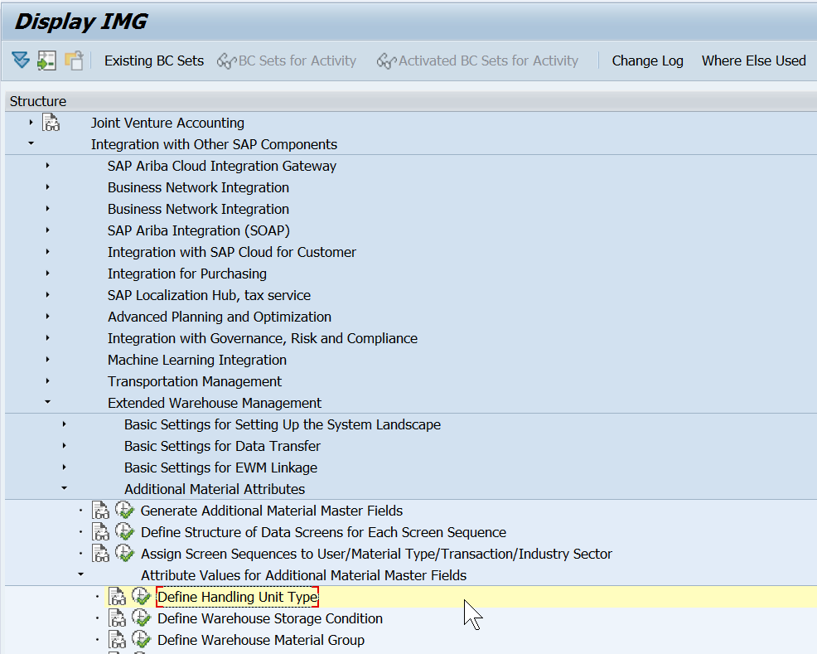
Define HU type
Describes the handling unit type of a packaging material, and replaces the storage unit type in Extended Warehouse Management.
SPRO > Integration with other SAP components > EWM > Additional material attributes > Attribute values for Additional Material master Fields > Define HU types
www.anubhavtrainings.com

Slide 23
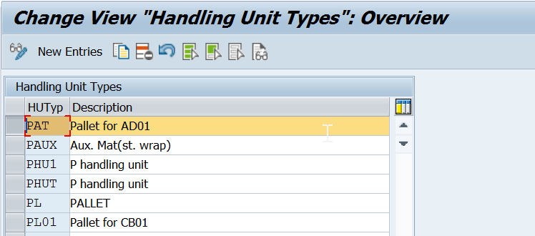
www.anubhavtrainings.com

Slide 24
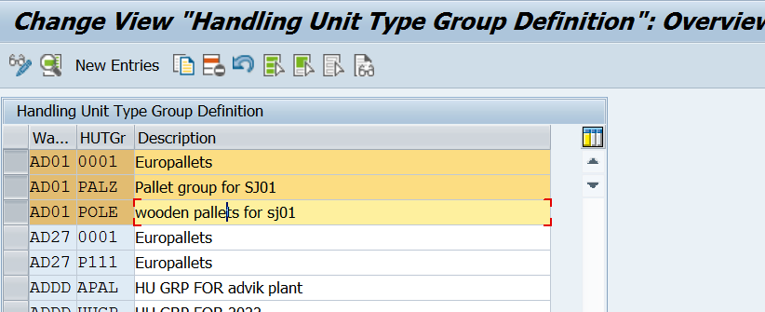
Define HU type
Groups handling unit types together according to their physical type.
E.g. HU Type group – Pallet
HU Type – Wooden pallet, Steel pallet, Normal pallet
www.anubhavtrainings.com

Slide 25
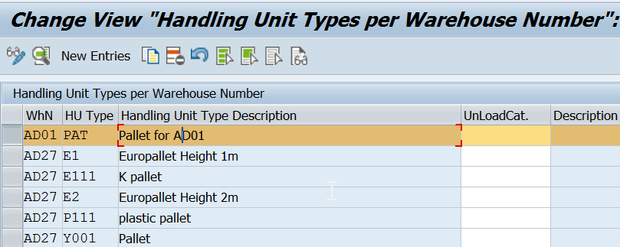
Define HU type for each warehouse number & assign HU type group (Same path)
www.anubhavtrainings.com

Slide 26
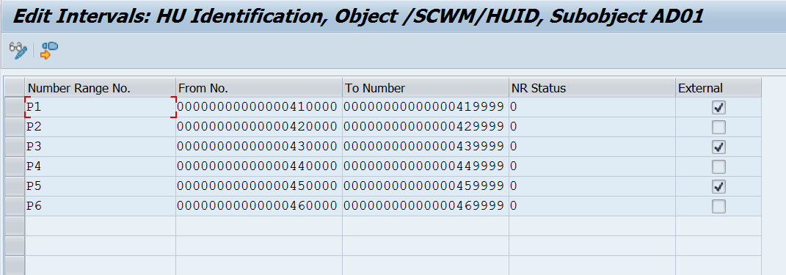
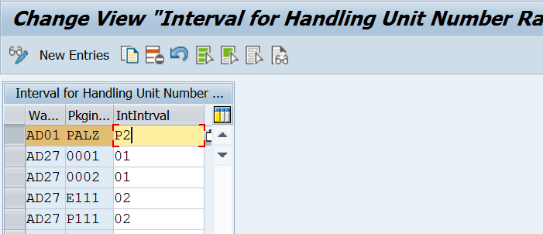
www.anubhavtrainings.com

Slide 27
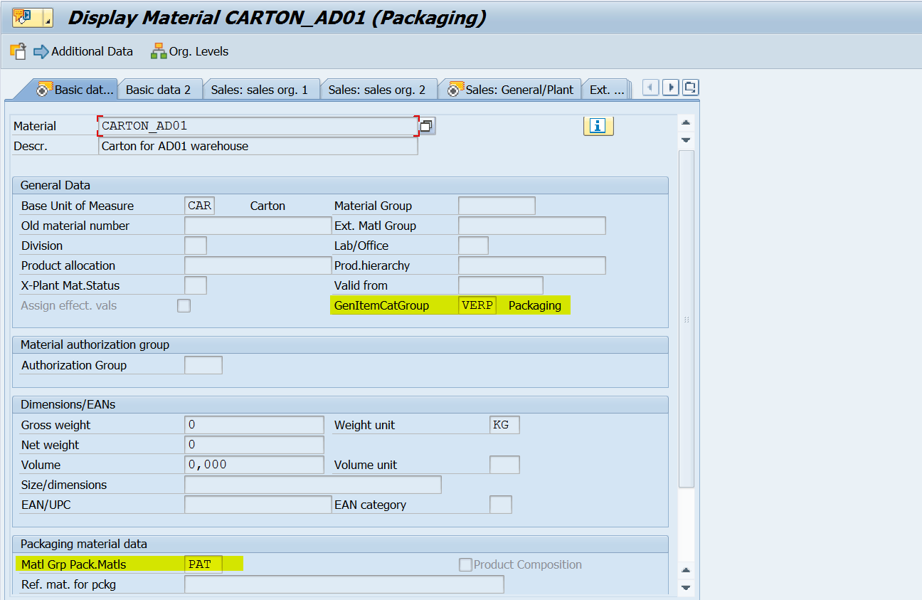
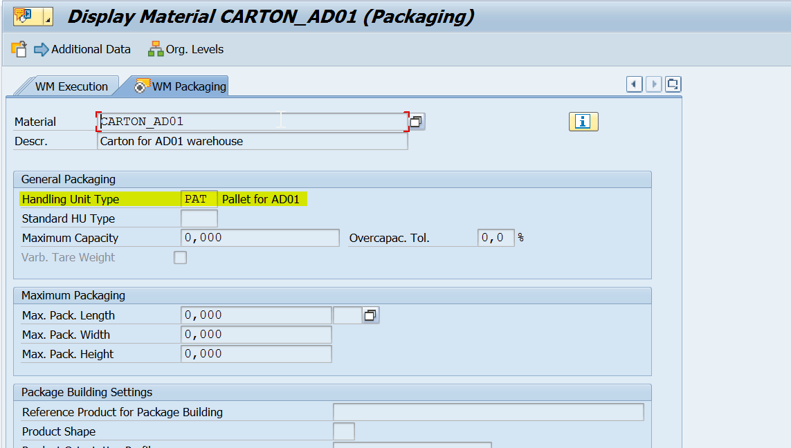
Create a Packaging Material (VERP) in ERP side MM01 (Basic data, Sales General data & WM packaging, WM Execution)
Assign Packing Group to Packaging Material type
www.anubhavtrainings.com

Slide 28


End of Session 05
www.anubhavtrainings.com

Slide 29

FEEL FREE TO ASK QUESTIONS

Slide 30

Feedback

Slide 31
THANK
YOU

Slide 32

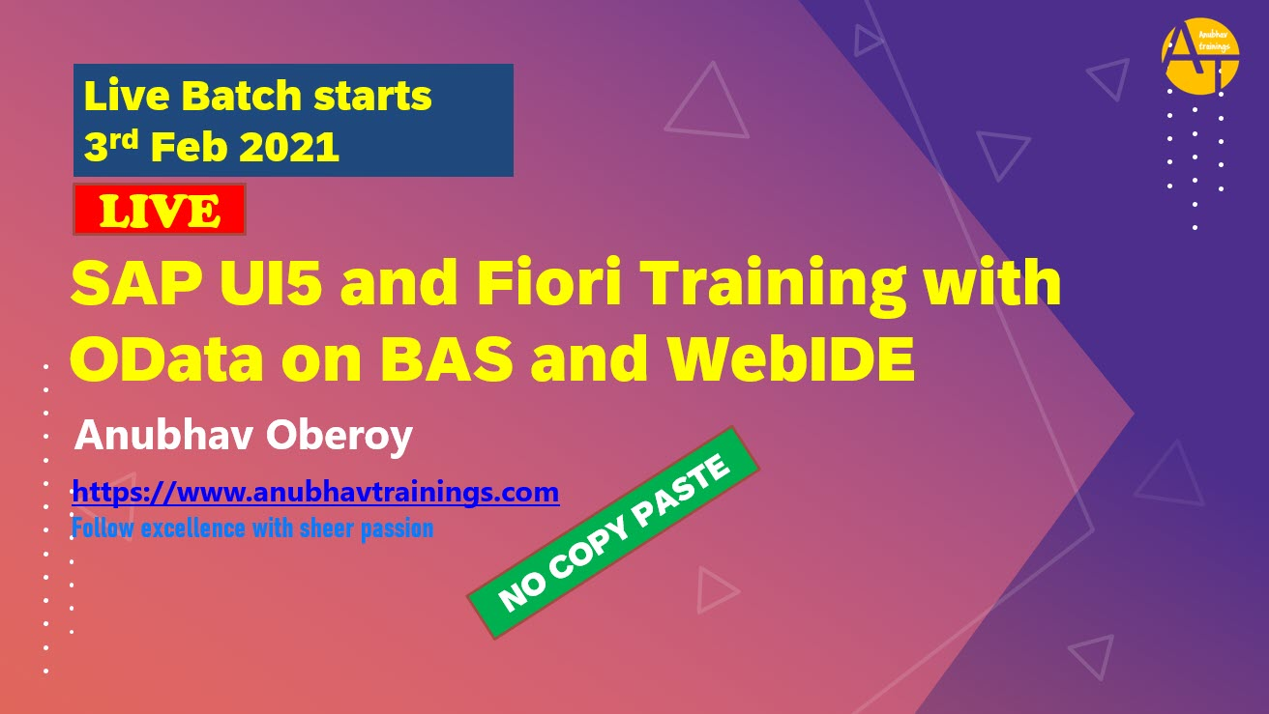

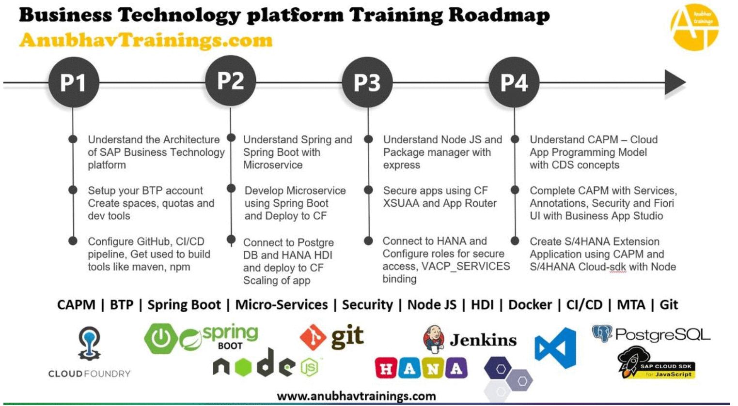
More from AnubhavTrainings.com

Slide 33






We’re committed to empower you to be
#FutureReady
through powerful training solutions.
We build the workforce of the future.
250+
Corporate Clients
30,000+
Learners Trained
25000+
Learners Placed
FREE WEBINARS
Sign up for free webinars with industry experts every fortnight!
Enroll Now!

Slide 34
FREE WEBINARS
Sign up for free webinars with industry experts every fortnight!
Contact us today!
www.anubhavtrainings.com

